Slide 1
Miniproject 2: APIs and Data Wrangling
Niklas Bergen
July 30, 2021
Notes:
Anurag’s comments:
Real-life data science projects typically are at least 3 months
No code at all, or screenshots from Jupyter labs
Don’t make your audience work for your visualizations
Evaluate presentation from this perspective: “you are an owner of a company, and somebody presents you this presentation”.
Focus on the big picture and the business problems you are solving. (How does the business earn money?)
Practice talking to non-technical audience (how to explain API to a 5 year-old)

Slide 2


Outline
Objectives
Methods Used
Results
Challenges

Slide 3


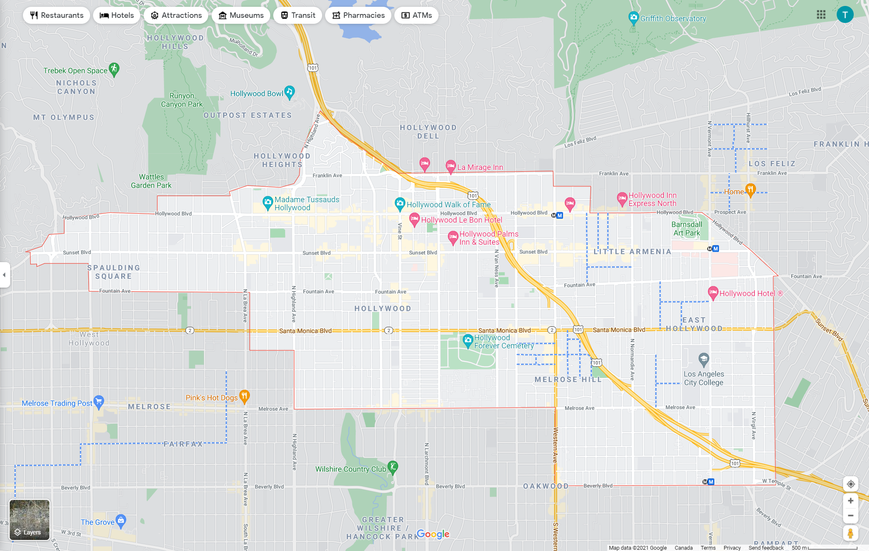

Objectives
Find the best things to do in Hollywood
Location:
5 km
Categories: active, arts, shopping
Limit: 50 results
Notes:
Compare yelp & Foursquare APIs functionality and results
Searching for venues located from

Slide 4
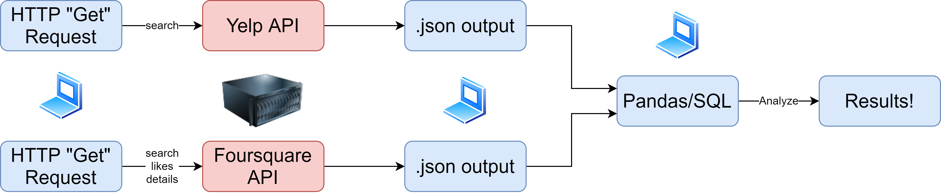
Objectives
Workflow
Notes:
Business search api endpoint
Presentation will focus on pandas, not SQL

Slide 5
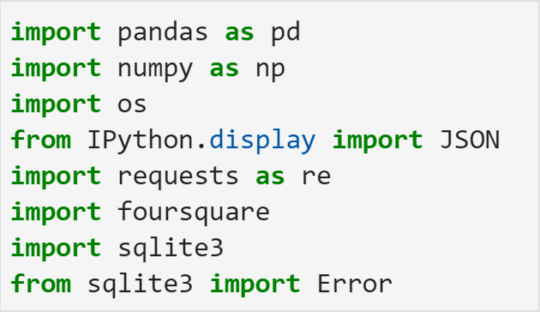

Methods Used
Jupyter Lab
Packages

Slide 6
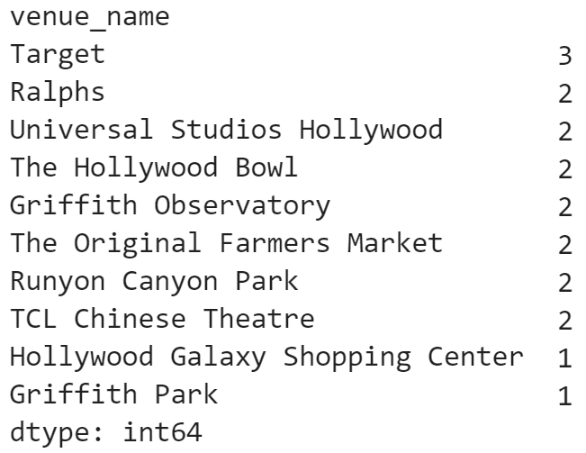

Results
Full query comparison (n = 50 + 46)
Venue Counts
Notes:
Six common venues (Target and Ralphs were obtained multiple times in Foursquare query).
Insight: only 12.5% of the search results were common between both APIs

Slide 7
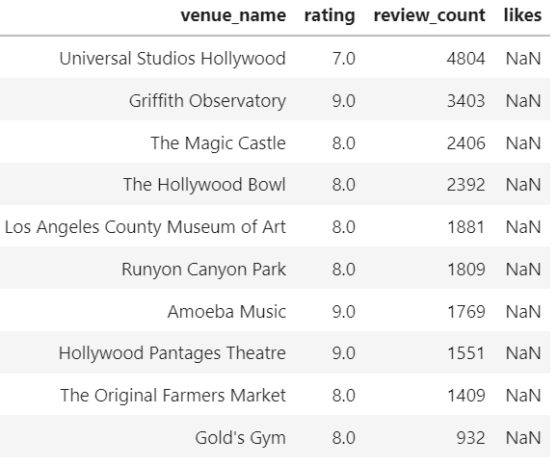
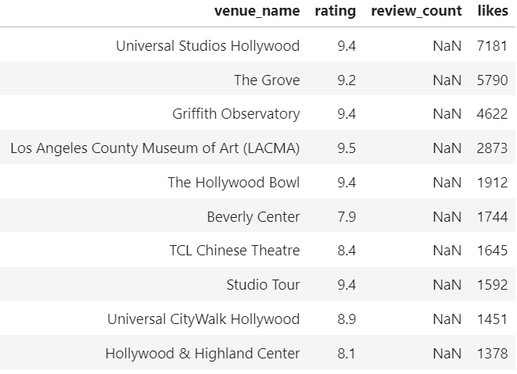
Results
Top 10 comparison (n = 10 + 10)
Notes:
Insight: search algorithms return much similar results for top 10 (40% compared to 12.5%)

Slide 8

Results
My favorite API:
More detailed response body
Review-based
Returned full 50 results
5000 Daily API limit, no premium
Notes:
Larger response body for search endpoint
Review-based, harder to game the system compared to likes (see what generates the most buzz)
Returned full 50 results, and no duplicates

Slide 9

Challenges
Manipulating dataframes
Watching for typos (API query parameters)
Notes:
If I had more time: setting up charts to compare ratings across platforms in double-bar charts

